Slide 1
Ethnicity & Mental Health Improvement Project: A New Beginning Merton Mental Health Programme Board 11 February 2021
Professor Sashi Sashidharan: Consultant Psychiatrist, Hon Professor in the Institute of Health & Wellbeing at University of Glasgow
Malik Gul: Director of Wandsworth Community Empowerment Network and PhD candidate in Social Networks and Healthcare, Dept of Primary Care & Public Health, Imperial College London

Slide 2
Context and Introduction

Slide 3
Ethnic inequalities in mental health
Ethnic disparities
Access
Experience
Outcomes
Across all BME groups compared to white people
Across all aspects of mental health care
Across the country
Persistent and worsening

Slide 4
Ethnic inequalities in access
↓ Contact with GPs / primary care services
↓ Recognition of mental health problems at primary care
Access to specialist mental health services
Aversive care pathway
Crisis / unscheduled care
Police and criminal justice system
Greater risk of hospital admission

Slide 5
Ethnic inequalities in experience and outcomes
Compulsory admissions / MHA ↑
Coercive interventions ↑
Length of stay ↑
Satisfaction ↓
Social outcomes ↓
After care and follow-up ↓
Readmissions ↑
CTO ↑

Slide 6
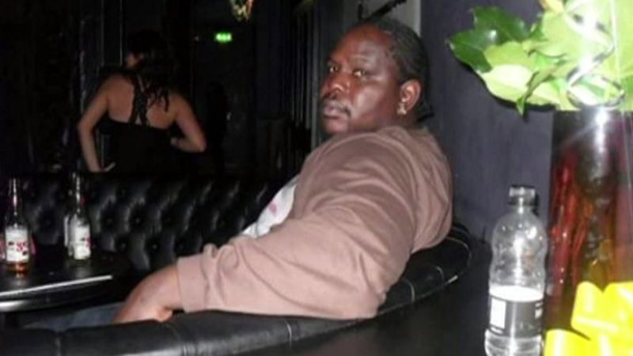
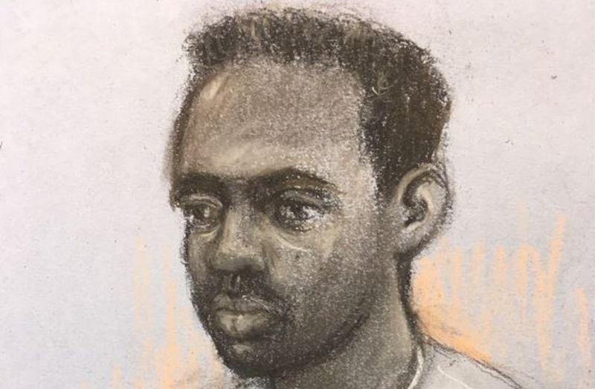
Why EMHIP?
Kevin Clarke, 35, died in police custody at Lewisham Hospital in March 2018.
Zephaniah McLeod, 27, charged with murder and 7 counts of attempted murder after a series of stabbings in Birmingham on 6 Sep 2020

Slide 7
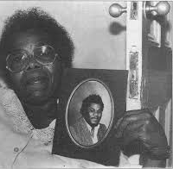
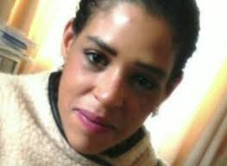
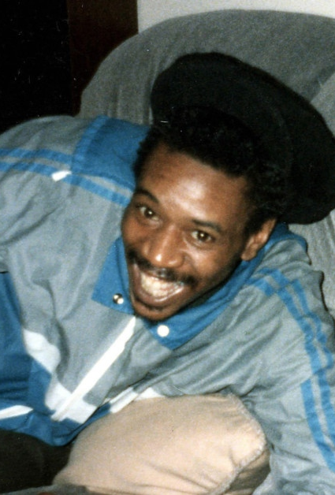
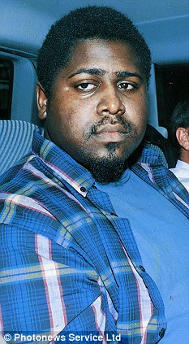
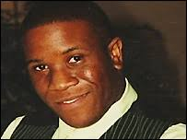
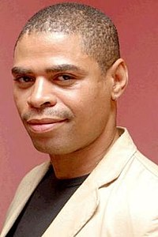
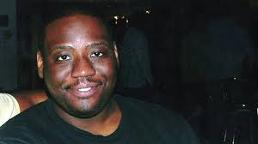
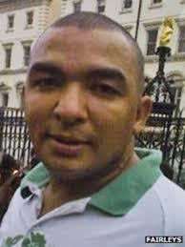
BME Mental Health – No Change……..
From top left clockwise: Clara Buckley with picture of her son, Orville Blackwood, Kingsley Burrell, Sarah Reed, David Bennet, Colin Grant, Leon Briggs, Sean Riggs, Roger Sylvester, Christopher Clunis, Oleseni Lewis, and many, many more…

Slide 8
BME Mental Health – treatment paradox
No care
Toxic care
Poor care
Quality
Safety

Slide 9
What is EHMIP?
Clinically-led partnership with the aim of reducing inequalities in access, experience and outcome of mental health care and thus improve patient safety and quality of care
Practical, locality-based service improvement programme, co-designed with users and based on established evidence
A collaborative partnership:
South West London CCG
SWL and St George’s Mental Health NHS Trust
The local network of BME voluntary, faith and community groups, organised via the non-profit, Wandsworth Community Empowerment Network (WCEN)

Slide 10
The Interventions

Slide 11
EMHIP: from evidence to interventions
Identify the key themes
Knowledge
Identify the areas for change
Overview of MH Services
Identify the high impact interventions
Fit-for-purpose
Evidence
Engagement with local stakeholders
Overview of Community Assets
Critical points of ethnic inequality in the care pathway
Deliverable in the local context
Notes:
Sashi – outline process of taking EMHIP from evidence base to development of interventions

Slide 12
Five Key Interventions
Establish Mental Health and Wellbeing Hubs with Community Embedded MH Workers
Increase BME service options
Crisis residential alternatives: Crisis House and Crisis Family Placements
Enhanced support for people with SMI: Community partnerships
Assertive Community Treatment: SMI + MHA + CJS + non-adherence
3. Reduce restrictive/coercive practices
Reduce MHA admissions
Eliminating the use of Restraint & Control
4. Enhance inpatient care
Community involvement in inpatient care
Cultural mediation
5. Ensure Culturally Capable Workforce
Notes:
Sashi – summarise key interventions and methodology for arriving at them

Slide 13
Proposed high-level MH patient pathway
1
Early Detection High Impact Interventions:
Mental Health & Wellbeing Hubs
Community Mental Health Workers
Community
2
Prevention and Personalisation High Impact Interventions:
Crisis House
Crisis Family Placements
Enhanced support for people with SMI: Community partnerships
Assertive Community Treatment
Pre Hospital
3
Inpatient Care High Impact Interventions
Inclusive and shared decision-making
Eliminating the use of Restraint & Control
Community involvement in inpatient care
Cultural meditation
Ensure culturally capable workforce
Hospital
Notes:
Jayne

Slide 14
Wandsworth Health & Wellbeing Hubs

Slide 15
The current system is fragmented and results in inequalities
Community System
Clinical System
Community Transport
Older Peoples Care
Primary Care
Pharmacy
Child Welfare
Community Organisations
Employment Assistance
Specialist Mental Health
Clinical Services
Post, sub-acute care
Relationship Education
Healthy Food Options
Public Health
Community Health
Advice & Advocacy
Pastoral Care
Physical Health
Urgent Care

Slide 16
The proposal: An integrated Community & Clinical Ecosystem, utilizing a hub and spoke model
Community Transport
Older Peoples Care
Primary Care
Pharmacy
Health & Wellbeing Hubs
Employment Assistance
Specialist Mental Health
Clinical Services
Post, sub-acute care
Child Welfare
Relationship Education
Healthy Food Options
Public Health
Community Health
Advice & Advocacy
Pastoral Care
Physical Health
Urgent Care

Slide 17
Wandsworth: Community Assets
Caius House Youth Centre
Mushkill Aasaan
New Testament Assembly
Deeper Christian Life Ministry
Shree Ghanapathy Temple
Battersea Mosque
Elays Network
Gatton Mosque
Eritrean Muslim Community Association

Slide 18
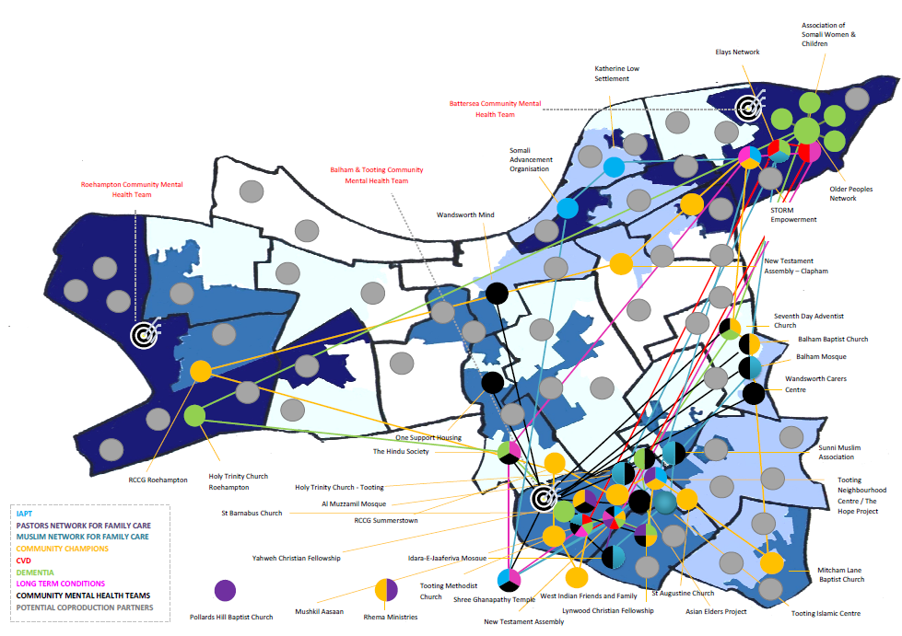
Wandsworth: Community-led Health & Wellbeing Ecosystem

Slide 19
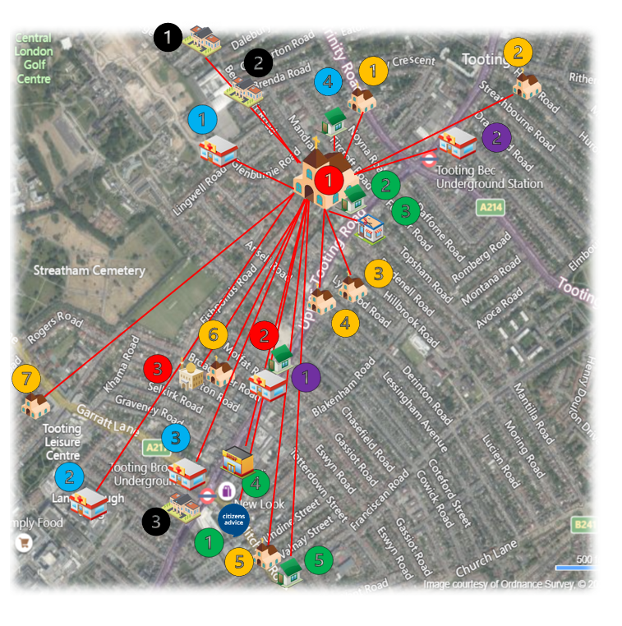
Health & Wellbeing Hub 1: New Testament Assembly Church
Key
Potential Network Partners: EMHIP Sites
1 – New Testament Assembly Church
1 – Mushkil Aasaan
2 – Al Muzzammil Mosque
Potential Network Partners: Churches
1 - Holy Trinity
2 – Balham Seventh Day Adventist Church
3 – Lynwood Christian Fellowship
4 – UCKG Help Centre
5 – Tooting United Reform Church
6 – St. Augustine’s
7 – Yahweh Christian Fellowship
Potential Network Partners: Community Groups
1 - Tooting Neighbourhood Centre/ Hope for Wellbeing Project
2 – Citizen’s Advice Wandsworth – Tooting Library
3 – DB Barbers
4 – Tooting Market
5 – Be Enriched
Potential Network Partners: Statutory Agencies
1 – South West London & St. George’s Mental Health NHS Trust
2 – St. George’s University Hospitals NHS Foundation Trust
3 – Talk Wandsworth IAPT
4 – Tooting Hub
Potential Network Partners: Primary Care Networks
1 - Grafton Medical Partners: Grafton PCN
2 - Tooting Bec Surgery: Balham, Tooting & Furzedown PCN
Potential Network Partners: Education Centres
1 – Nightingale Community Academy
2 – Ernest Bevin College
3 – South Thames College

Slide 20
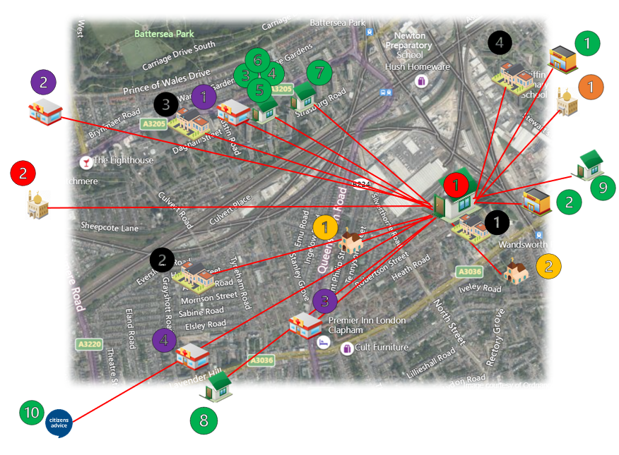
Health & Wellbeing Hub 2: Elays Network
Key
Potential Network Partners: EMHIP Sites
1 – Elays Network
2 - Islamic Culture & Education Centre
Potential Network Partners: Churches
1 – Ethiopian Orthodox Church St. Mary
2 – St. Paul’s Church
Potential Network Partners: Mosques
1 – Eritrean Muslim Community Association
Potential Network Partners: Community Groups
1 – Eritrean and Ethiopian restaurants
2 – Orit Ethiopian restaurant
3 – Wandsworth Community Empowerment Network
4 – Association of Somali Women & Children
5 – Doddington & Rollo Community Association
6 – STORM Family Centre
7 – Waste not Want Not
8 – DEVAS Club
9 – FAST Charity
10 – Citizen’s Advice Wandsworth
Potential Network Partners: Primary Care Networks
1 – Battersea Fields Medical Practice: Battersea PCN
2 – Bridge Lane Group Practice: Battersea PCN
3 – Queenstown Road Medical Practice: Battersea PCN
4 – Lavender Hill Group Practice: Battersea PCN
Potential Network Partners: Education Centres
1 – Heathbrook Primary School
2 – Shaftsbury Park Primary School
3 – Harris Academy
4 – Griffin Primary School

Slide 21
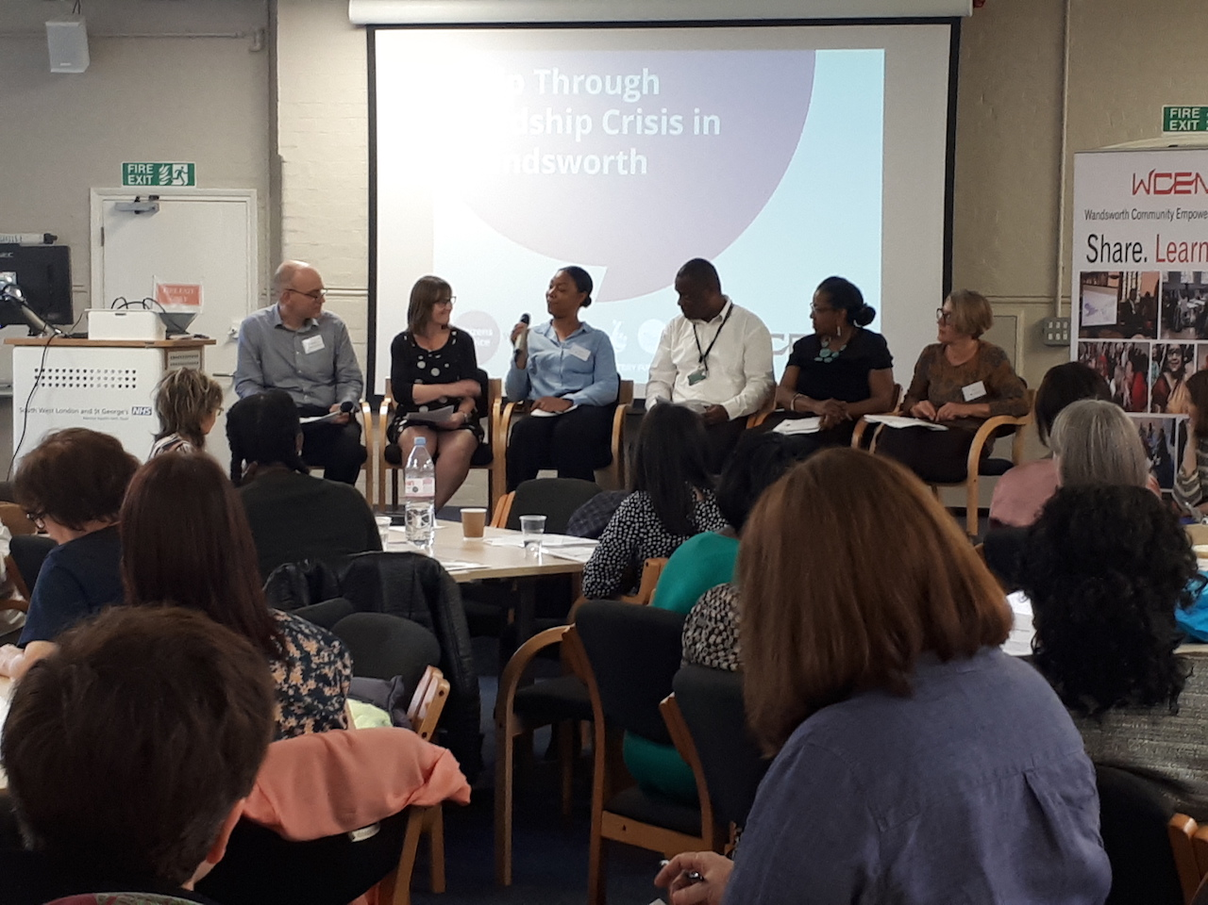
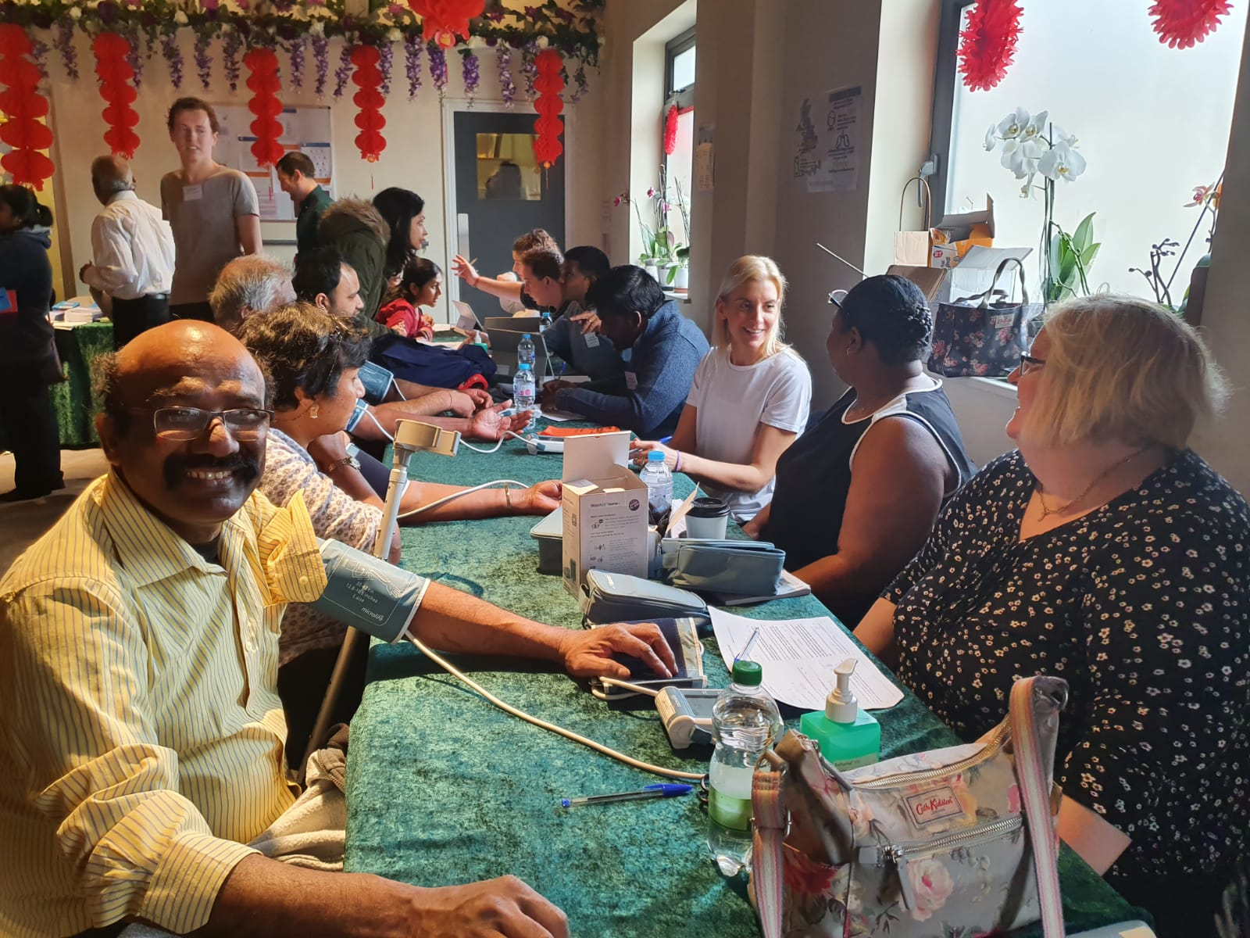
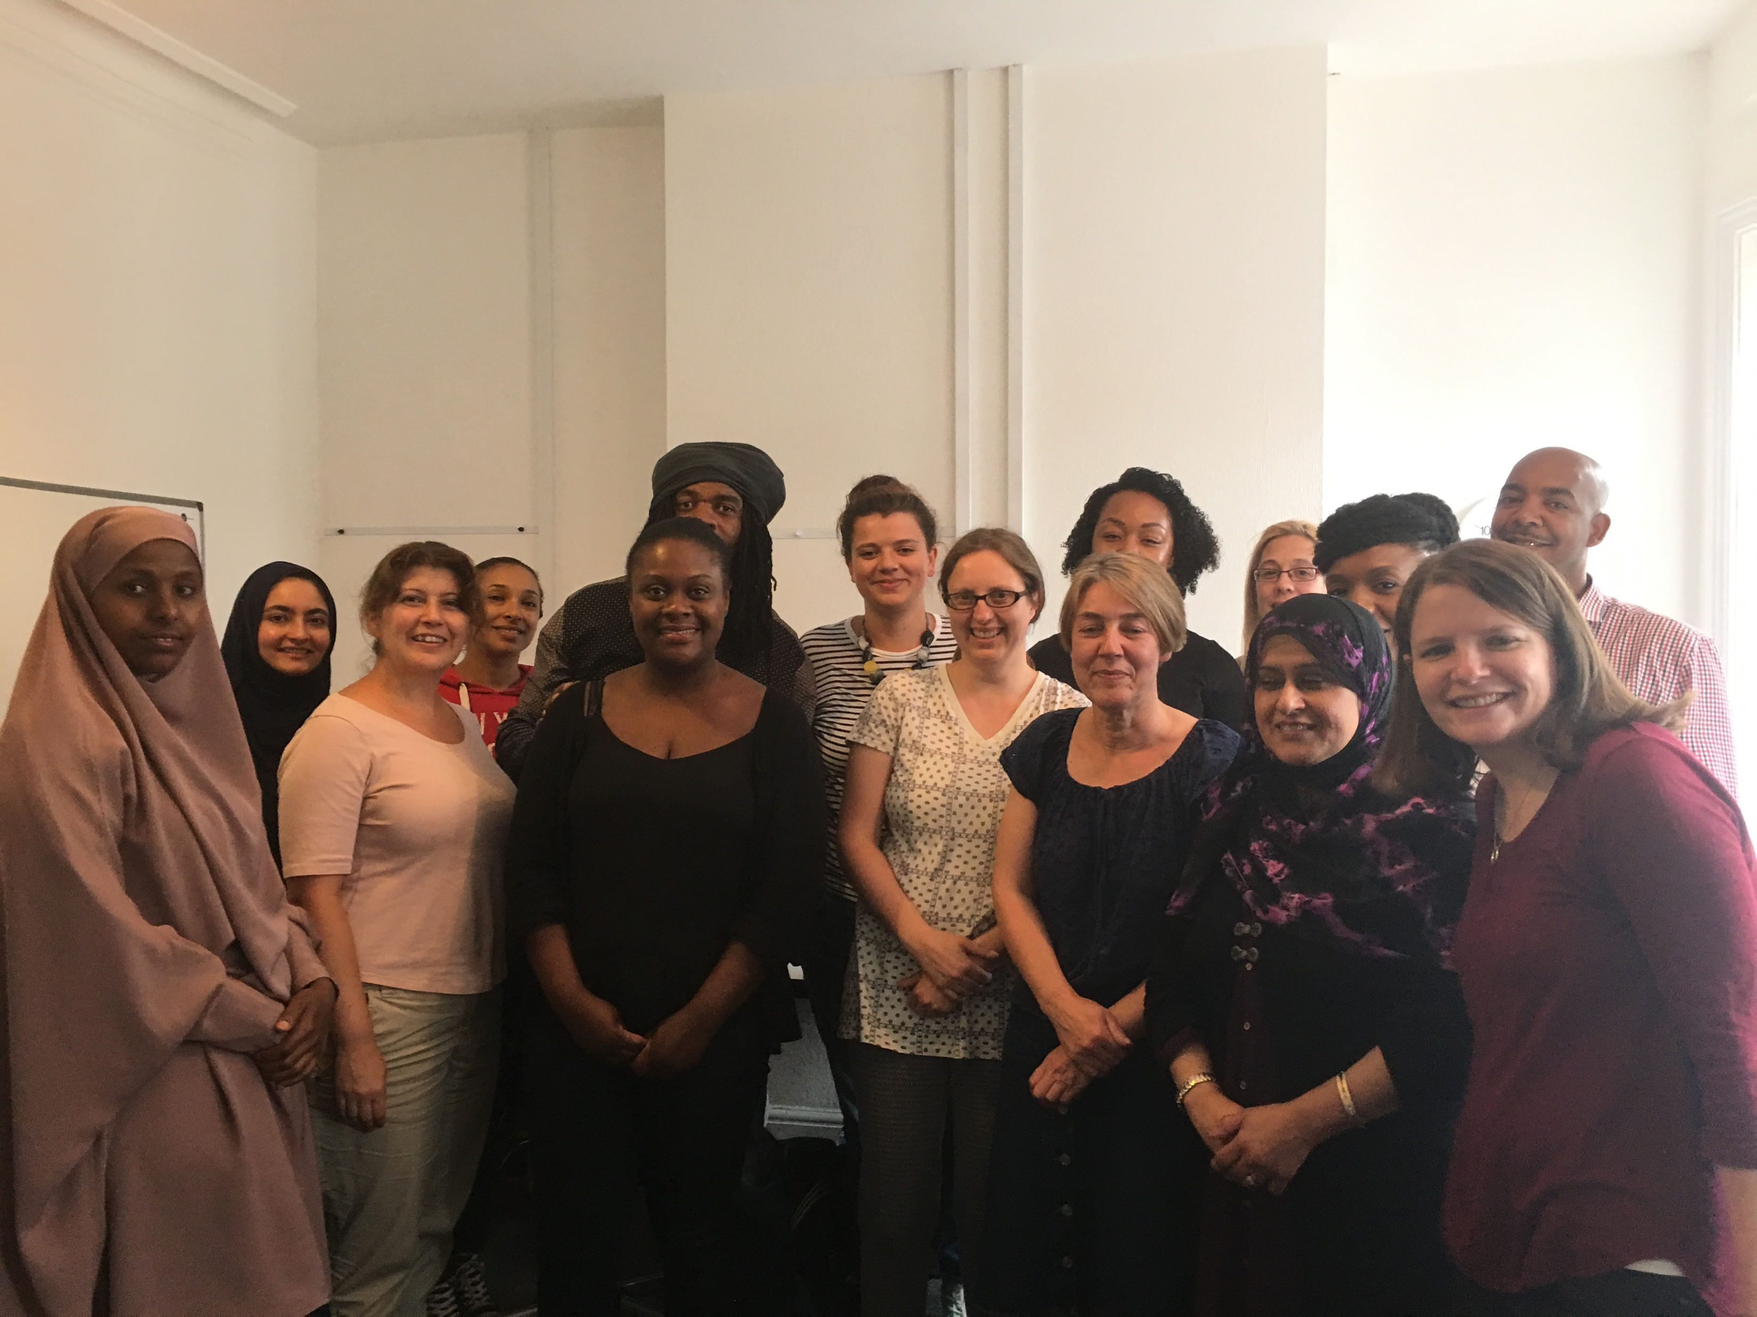
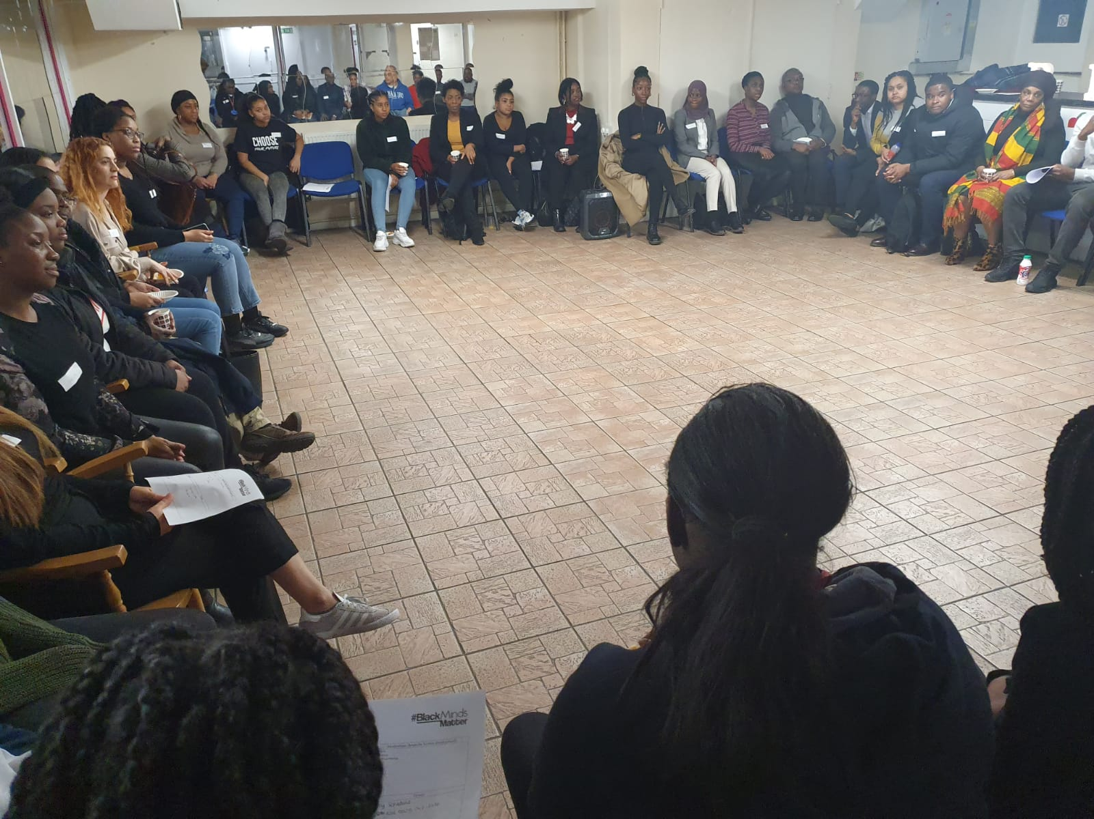
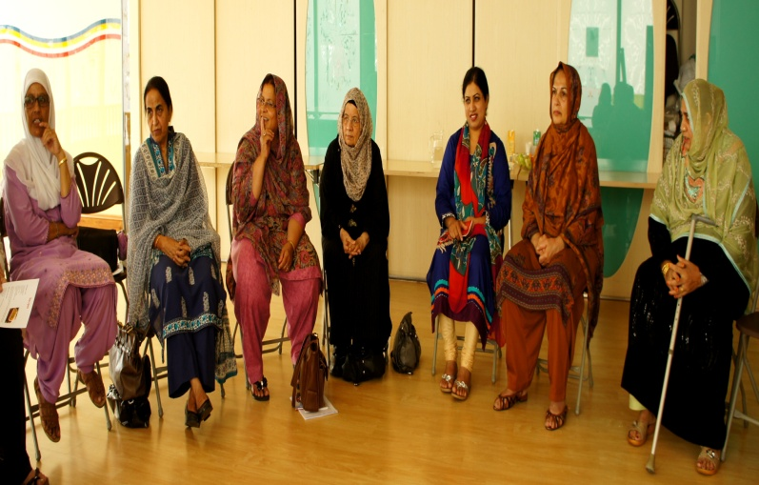
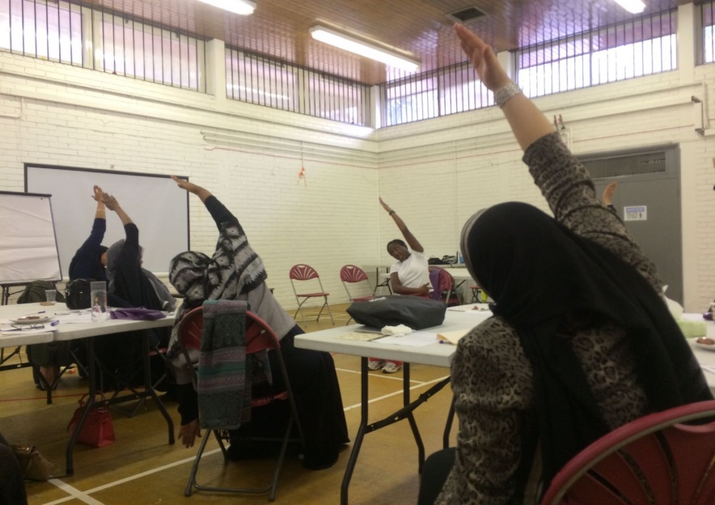
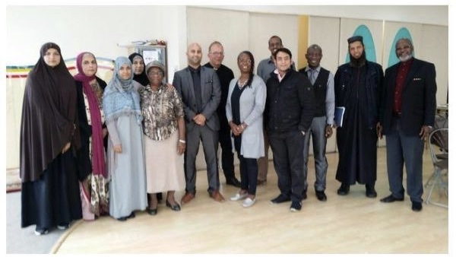
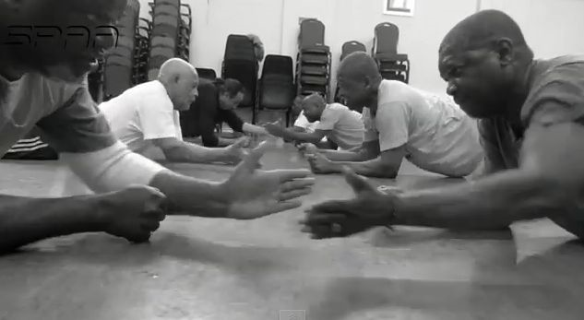
Co-produced projects successfully delivered
Healthcare Conferences & Forums
Community-Led Health Clinics
Advice First-Aid
Black Minds Matter
Children and Young People
Culturally-Adapted Talking Therapies
Self Management Programs
Family Therapy Networks
Exercise and Well Being

Slide 22
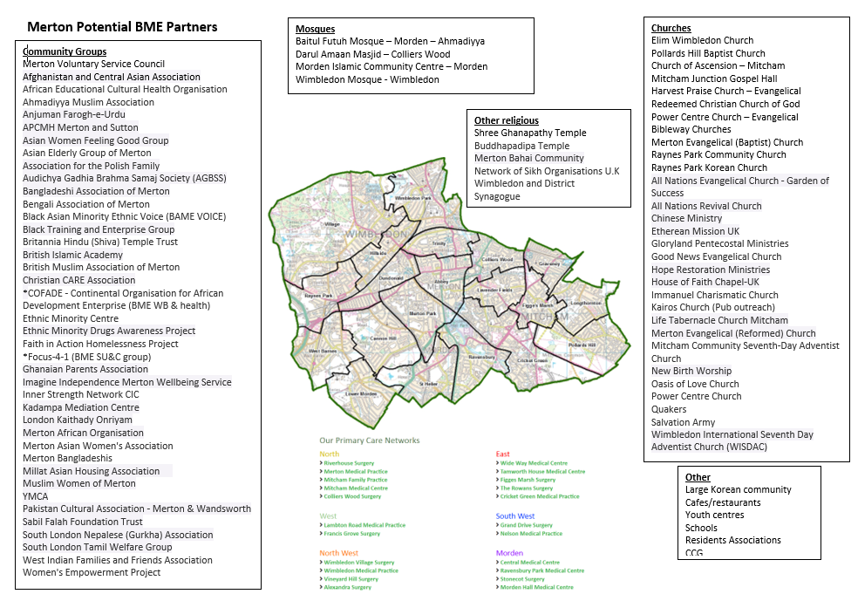

Slide 23
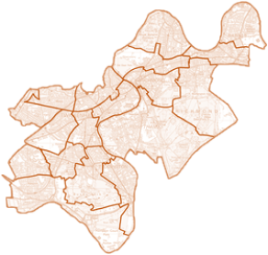
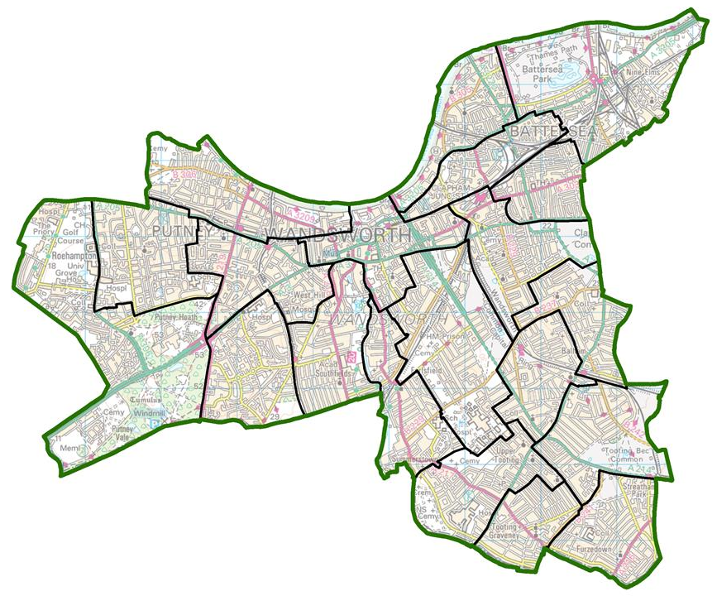
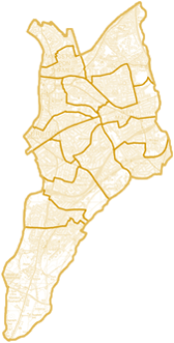
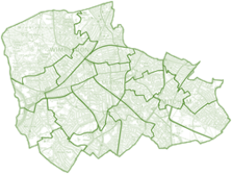
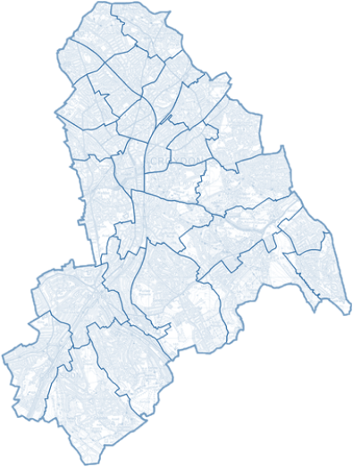
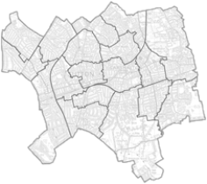
SW London Community-Led Health Eco-System
Adapt, Spread, Scale
Wandsworth
Richmond Upon Thames
Merton
Croydon
Kingston Upon Thames
Sutton

Slide 25
For programme updates, information, reports, audits, hubs, media, contacts and/or how to get involved:
www.emhip.co.uk

