Slide 1
Ethnicity & Mental Health Improvement Project: A New Beginning South West London and St George’s Mental Health NHS Trust Annual Public Meeting Thursday, 17th September 2020
Presented by the EMHIP Leads
Professor Sashi Sashidharan: Consultant Psychiatrist, Hon Professor in the Institute of Health & Wellbeing at University of Glasgow
Malik Gul: Director of Wandsworth Community Empowerment Network and PhD candidate in Social Networks and Healthcare, Dept of Primary Care & Public Health, Imperial College London

Slide 2
Context and Introduction

Slide 3
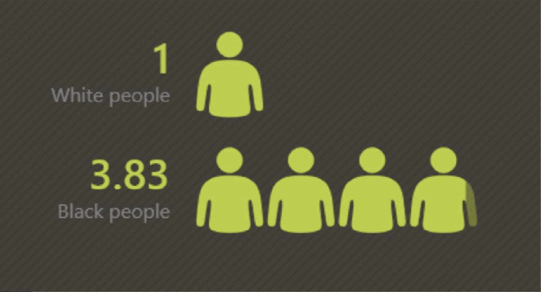
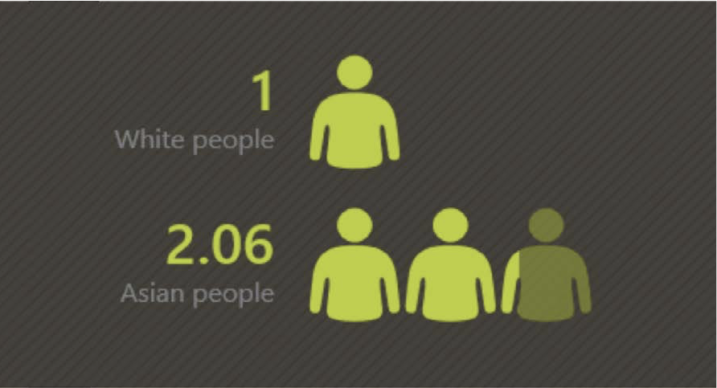
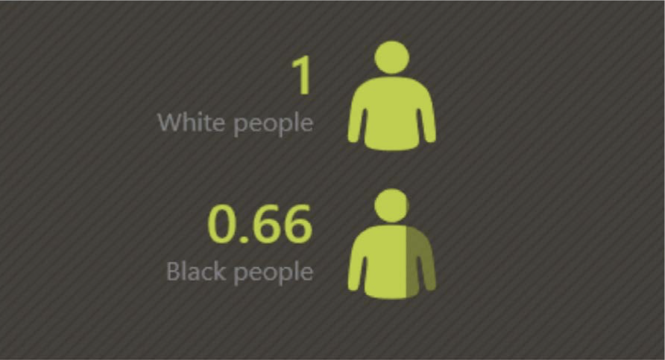
Context
Black and Minority Ethnic people are more likely to be compulsorily admitted to hospital compared with white people
Black and Minority Ethnic people are less likely to be in contact with GPs compared with white people
Black and Minority Ethnic people are significantly more likely to be readmitted to hospital
CTO use is highest for Black people - over 8 times the rate for white people
Black and Minority Ethnic people are 40% more likely to access mental health services via the criminal justice system than white people.
Source: Synergi Collaborative Centre

Slide 4
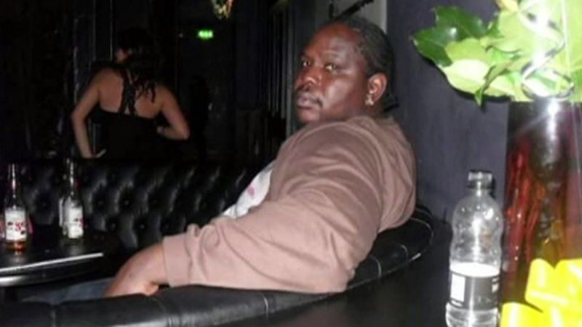
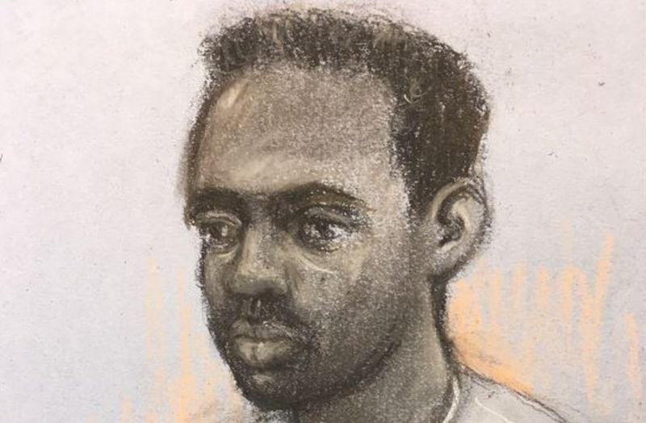
Why EMHIP?
Kevin Clarke, 35, died in police custody at Lewisham Hospital in March 2018.
Zephaniah McLeod, 27, charged with murder and 7 counts of attempted murder after a series of stabbings in Birmingham on 6 Sep 2020

Slide 5
BME Mental Health
No care
Toxic care
Poor care
Quality
Patient safety

Slide 6
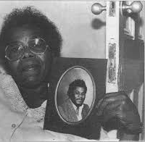
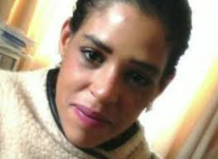
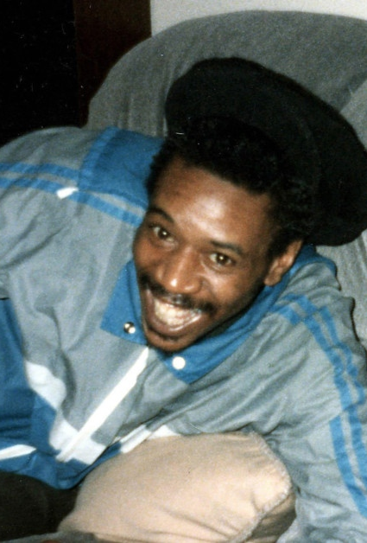
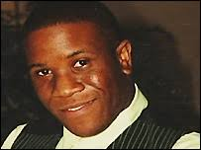
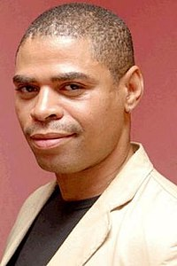
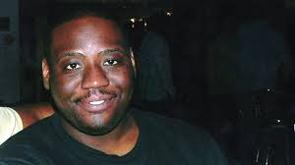
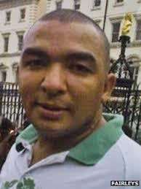
BME Mental Health – No Change……..
From top left clockwise: Clara Buckley with picture of her son, Orville Blackwood, Kingsley Burrell, Sarah Reed, David Bennet, Colin Grant, Leon Briggs, Sean Riggs, Roger Sylvester, Christopher Clunis, Oleseni Lewis, and many, many more…

Slide 7
What is EHMIP?
The Ethnicity and Mental Health Improvement Project (EMHIP) is a clinically-led partnership with a specific objective-reduce and ethnic inequalities in access, experience and outcome of mental health care
A practical, locality-based service improvement programme- co-designed with service users and local BME communities, based on established evidence, building on existing community-led coproduced projects.
A collaborative partnership:
South West London CCG
SWL and St George’s Mental Health NHS Trust
Local network of BME voluntary, faith and community groups, organised via the non-profit, Wandsworth Community Empowerment Network (WCEN)

Slide 8
The interventions

Slide 9
EMHIP: From evidence to interventions
Identify the key themes
Knowledge
Identify the areas for change
Overview of MH Services
Identify the high impact interventions
Fit-for-purpose
Evidence
Engagement with local stakeholders
Overview of Community Assets
Critical points of ethnic inequality in the care pathway
Deliverable in the local context
Notes:
Sashi – outline process of taking EMHIP from evidence base to development of interventions

Slide 10
Five Key Interventions
Establish Mental Health and Wellbeing Hubs with Community Embedded MH Workers
Increase BME service options
Crisis residential alternatives: Crisis House and Crisis Family Placements
Enhanced support for people with SMI: Community partnerships
Assertive Community Treatment: SMI + MHA + CJS + non-adherence
3. Reduce restrictive/coercive practices
Inclusive and shared decision-making
Eliminating the use of Restraint & Control
4. Enhance inpatient care
Community involvement in inpatient care
Cultural mediation
5. Ensure Culturally Capable Workforce
Notes:
Sashi – summarise key interventions and methodology for arriving at them

Slide 11
Proposed high-level MH patient pathway
1
Early Detection High Impact Interventions:
Mental Health & Wellbeing Hubs
Community Mental Health Workers
Community
2
Prevention and Personalisation High Impact Interventions:
Crisis House
Crisis Family Placements
Enhanced support for people with SMI: Community partnerships
Assertive Community Treatment
Pre Hospital
3
Inpatient Care High Impact Interventions
Inclusive and shared decision-making
Eliminating the use of Restraint & Control
Community involvement in inpatient care
Cultural meditation
Ensure culturally capable workforce
Hospital
Notes:
Jayne

Slide 12
Wandsworth Health & Wellbeing Hubs

Slide 13
The current system is fragmented and results in inequalities
Community System
Clinical System
Community Transport
Older Peoples Care
Primary Care
Pharmacy
Child Welfare
Community Organisations
Employment Assistance
Specialist Mental Health
Clinical Services
Post, sub-acute care
Relationship Education
Healthy Food Options
Public Health
Community Health
Advice & Advocacy
Pastoral Care
Physical Health
Urgent Care

Slide 14
The proposal: An integrated Community & Clinical Ecosystem, utilizing a hub and spoke model
Community Transport
Older Peoples Care
Primary Care
Pharmacy
Health & Wellbeing Hubs
Employment Assistance
Specialist Mental Health
Clinical Services
Post, sub-acute care
Child Welfare
Relationship Education
Healthy Food Options
Public Health
Community Health
Advice & Advocacy
Pastoral Care
Physical Health
Urgent Care

Slide 15
Wandsworth’s Community Assets
Caius House Youth Centre
Mushkill Aasaan
New Testament Assembly
Deeper Christian Life Ministry
Shree Ghanapathy Temple
Battersea Mosque
Elays Network
Gatton Mosque
Eritrean Muslim Community Association

Slide 16
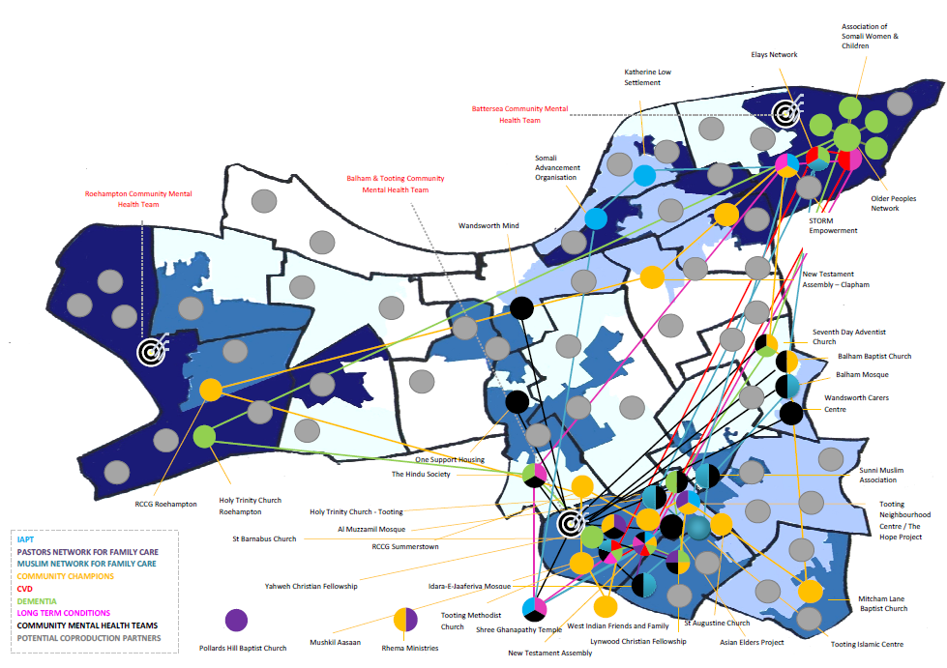
Wandsworth’s Community-led Health & Wellbeing Ecosystem

Slide 17
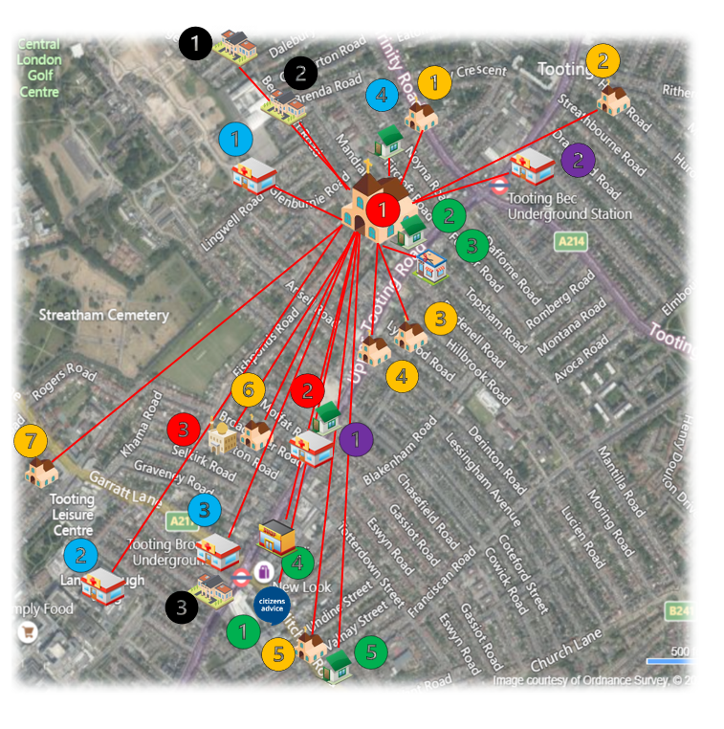
Health & Wellbeing Hub 1: New Testament Assembly Church
Key
Potential Network Partners: EMHIP Sites
1 – New Testament Assembly Church
1 – Mushkil Aasaan
2 – Al Muzzammil Mosque
Potential Network Partners: Churches
1 - Holy Trinity
2 – Balham Seventh Day Adventist Church
3 – Lynwood Christian Fellowship
4 – UCKG Help Centre
5 – Tooting United Reform Church
6 – St. Augustine’s
7 – Yahweh Christian Fellowship
Potential Network Partners: Community Groups
1 - Tooting Neighbourhood Centre/ Hope for Wellbeing Project
2 – Citizen’s Advice Wandsworth – Tooting Library
3 – DB Barbers
4 – Tooting Market
5 – Be Enriched
Potential Network Partners: Statutory Agencies
1 – South West London & St. George’s Mental Health NHS Trust
2 – St. George’s University Hospitals NHS Foundation Trust
3 – Talk Wandsworth IAPT
4 – Tooting Hub
Potential Network Partners: Primary Care Networks
1 - Grafton Medical Partners: Grafton PCN
2 - Tooting Bec Surgery: Balham, Tooting & Furzedown PCN
Potential Network Partners: Education Centres
1 – Nightingale Community Academy
2 – Ernest Bevin College
3 – South Thames College

Slide 18
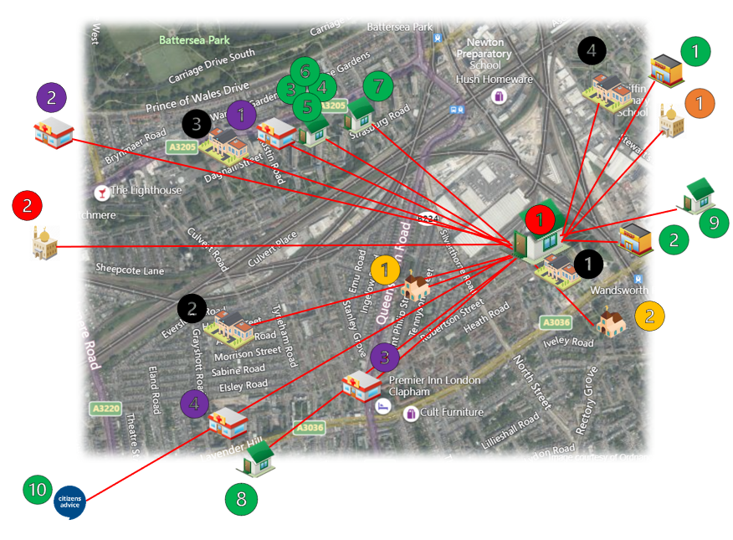
Health & Wellbeing Hub 2: Elays Network
Key
Potential Network Partners: EMHIP Sites
1 – Elays Network
2 - Islamic Culture & Education Centre
Potential Network Partners: Churches
1 – Ethiopian Orthodox Church St. Mary
2 – St. Paul’s Church
Potential Network Partners: Mosques
1 – Eritrean Muslim Community Association
Potential Network Partners: Community Groups
1 – Eritrean and Ethiopian restaurants
2 – Orit Ethiopian restaurant
3 – Wandsworth Community Empowerment Network
4 – Association of Somali Women & Children
5 – Doddington & Rollo Community Association
6 – STORM Family Centre
7 – Waste not Want Not
8 – DEVAS Club
9 – FAST Charity
10 – Citizen’s Advice Wandsworth
Potential Network Partners: Primary Care Networks
1 – Battersea Fields Medical Practice: Battersea PCN
2 – Bridge Lane Group Practice: Battersea PCN
3 – Queenstown Road Medical Practice: Battersea PCN
4 – Lavender Hill Group Practice: Battersea PCN
Potential Network Partners: Education Centres
1 – Heathbrook Primary School
2 – Shaftsbury Park Primary School
3 – Harris Academy
4 – Griffin Primary School

Slide 19
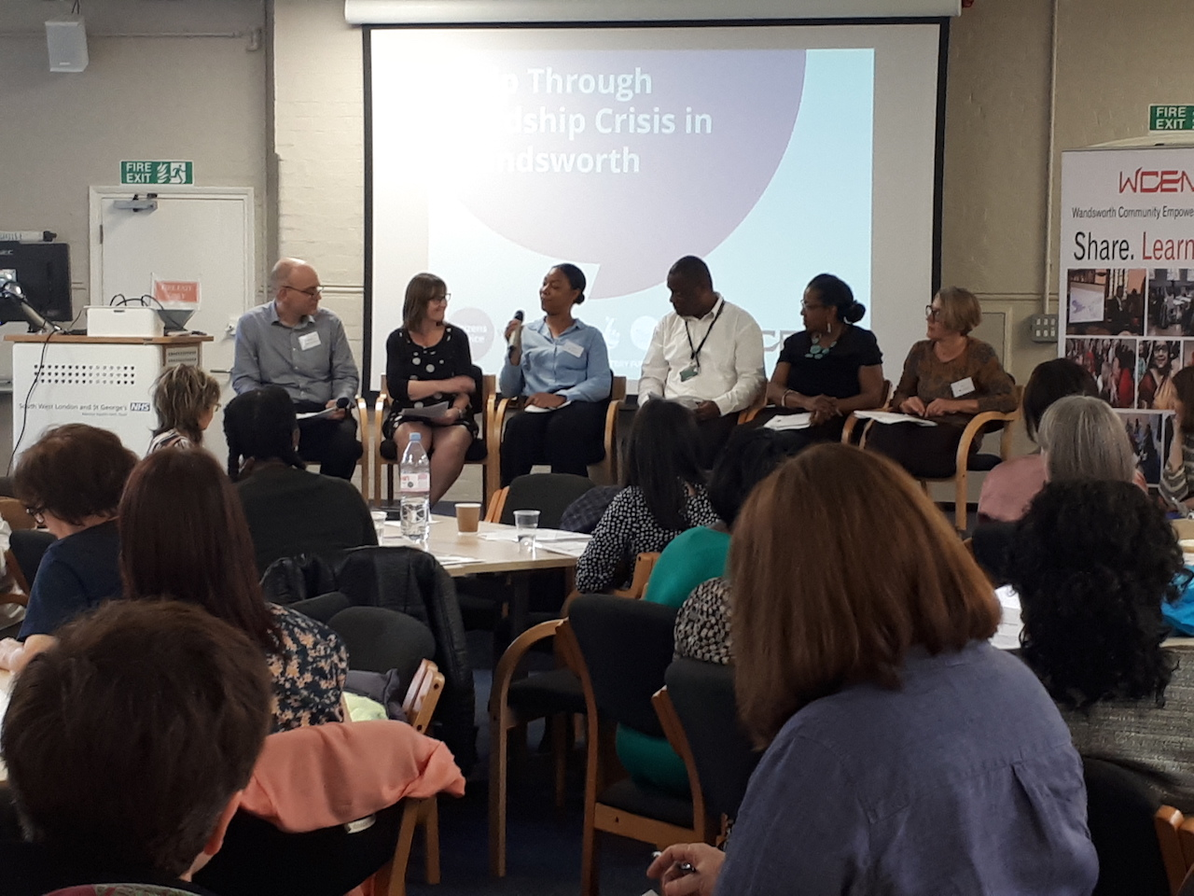
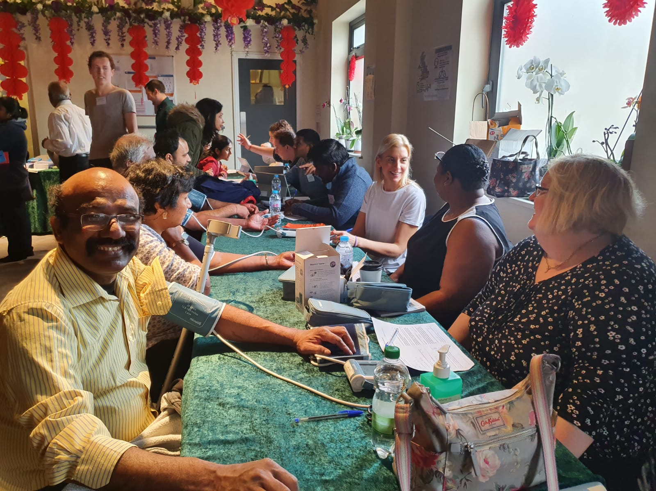
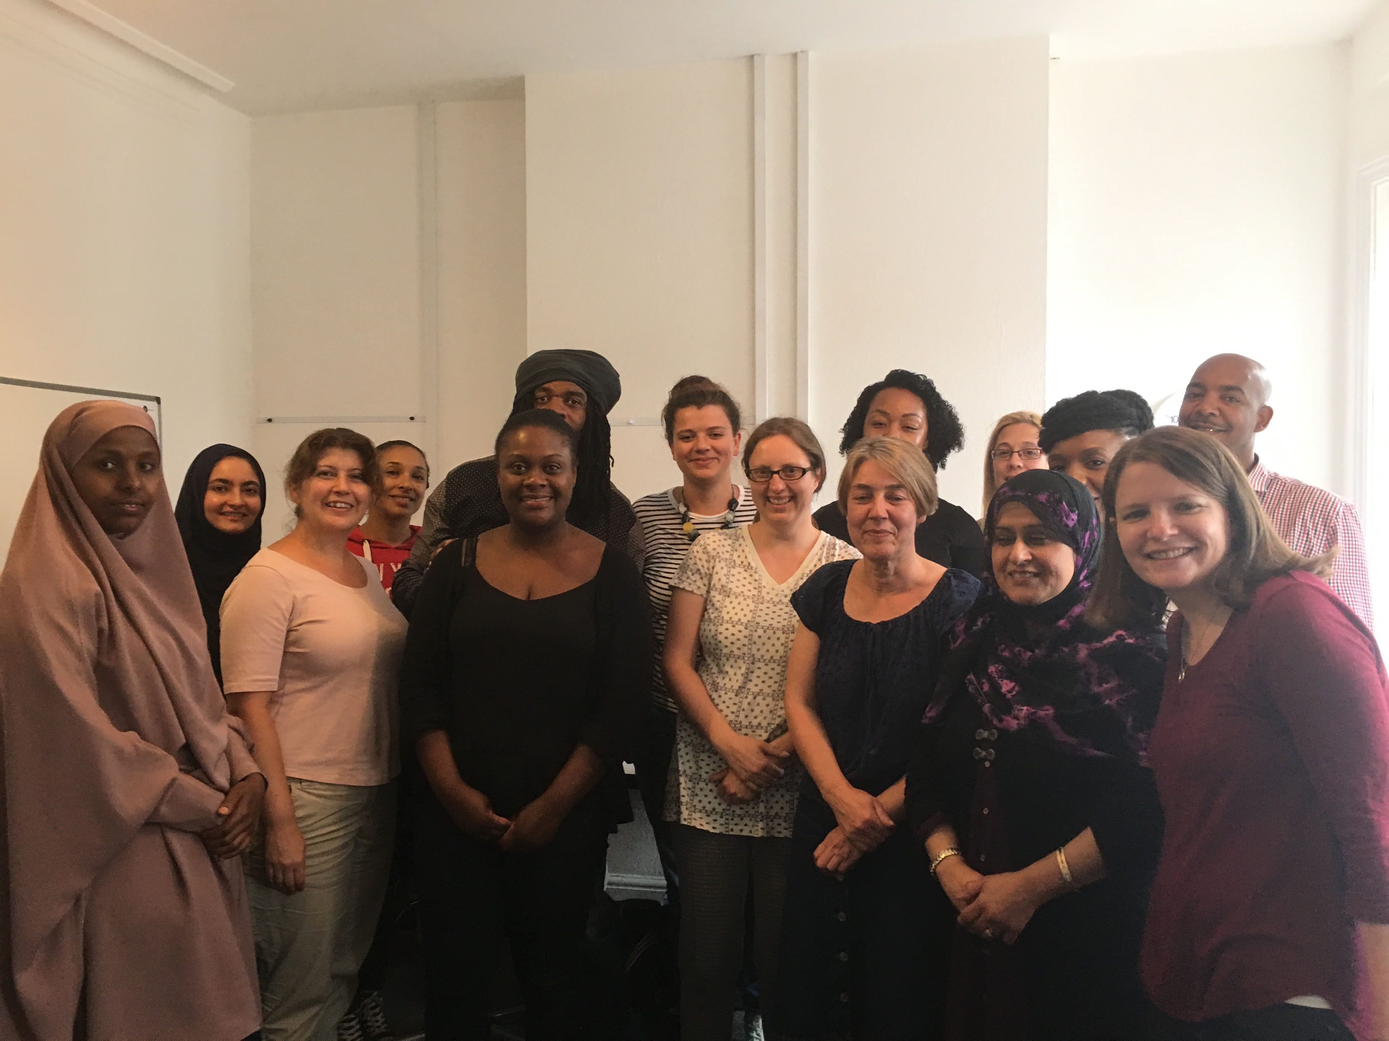
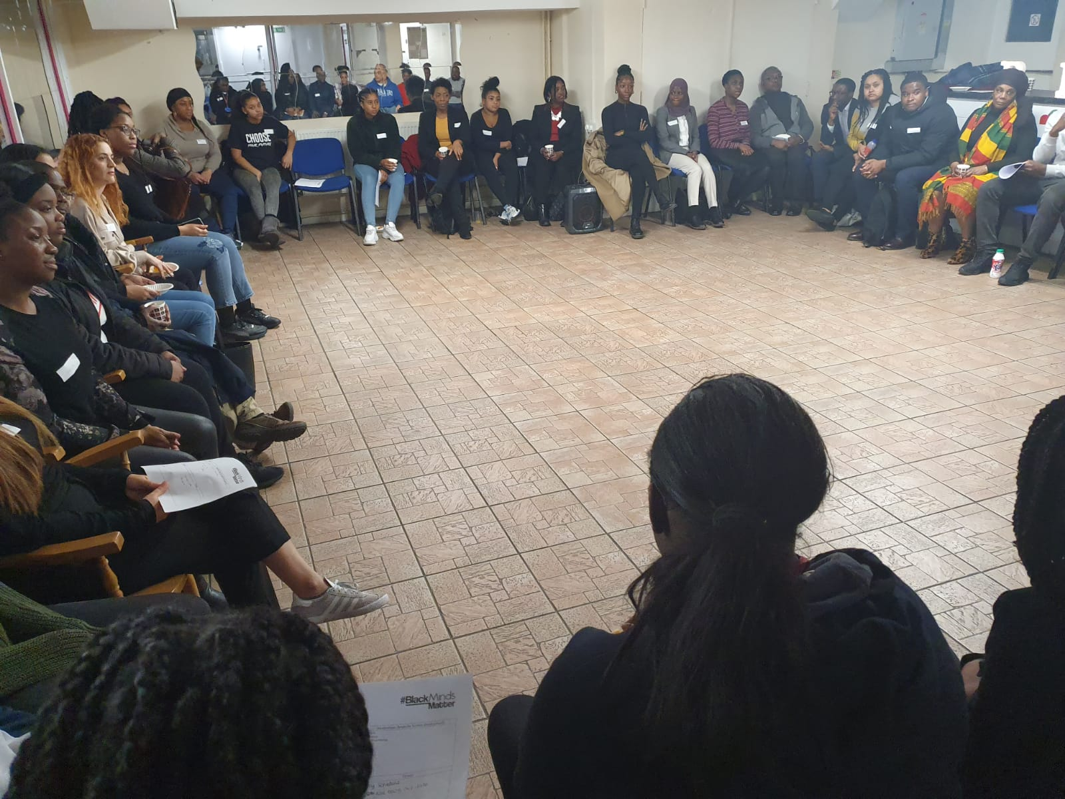
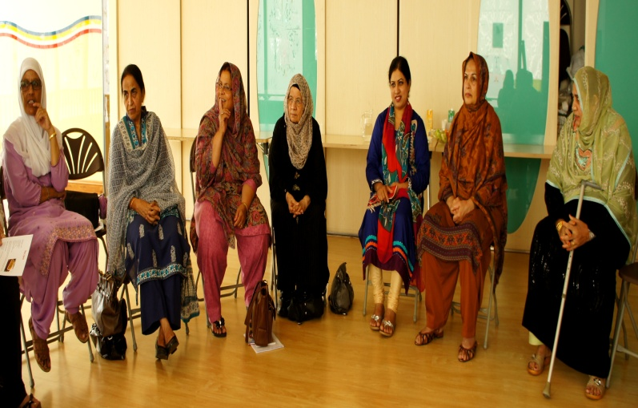
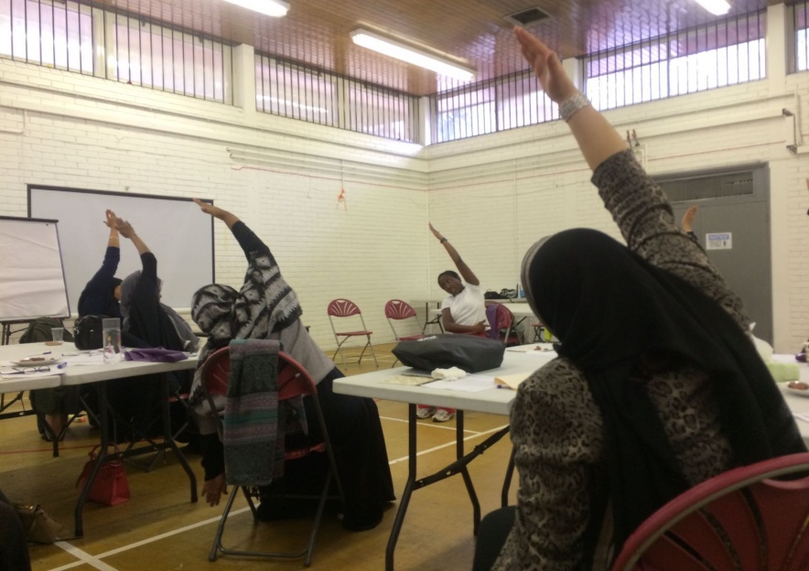
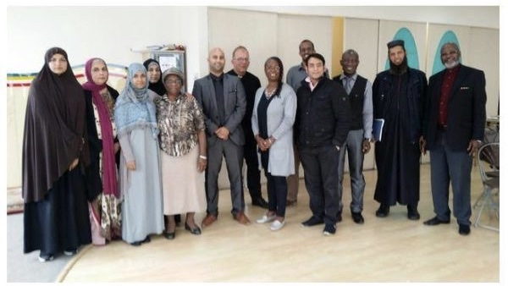
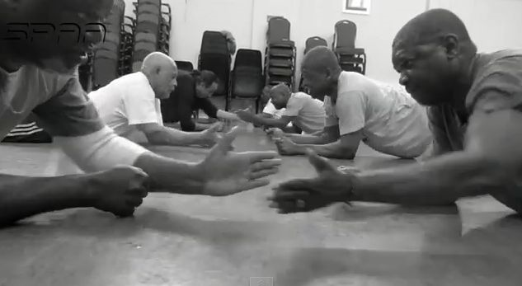
Co-produced projects successfully delivered
Healthcare Conferences & Forums
Community-Led Health Clinics
Advice First-Aid
Black Minds Matter
Children and Young People
Culturally-Adapted Talking Therapies
Self Management Programs
Family Therapy Networks
Exercise and Well Being

Slide 20
Next steps & How to get involved

Slide 21
The next steps
Business case completed and submitted. The funding decision is pending.
Agree implementation plan in consultation with community stakeholders
Deliver a 12-month pilot in Wandsworth
Collate data, monitor outcomes and evaluate, including an ethnicity audit throughout the period (baseline, 6 months and 12 months)
Share learning and practice, including academic publication
Expand mental health & wellbeing hubs and services including physical health
Adapt, scale-up and scale across, via a commissioned service

Slide 22
For programme updates, information, reports, audits, hubs, media, contacts and/or how to get involved:
www.emhip.co.uk

